Slide 1
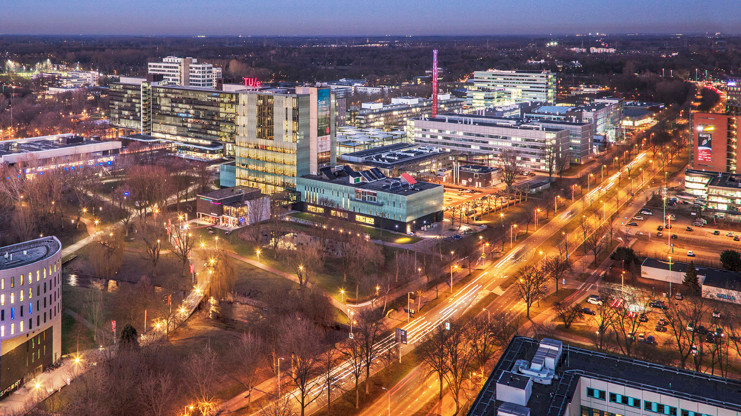
Research on Coaching Practices - Industrial Design department
24/02/2022
Sonia Gomez Puente and Karolina Doulougeri – Miguel Bruns
Industrial Design

Slide 2
Agenda
Introduction to research project: “Coaching in ID"
Educational model ID
Research questions & Methods
Preliminary results
Conclusions
Recommendations for practice
Future research

Slide 3
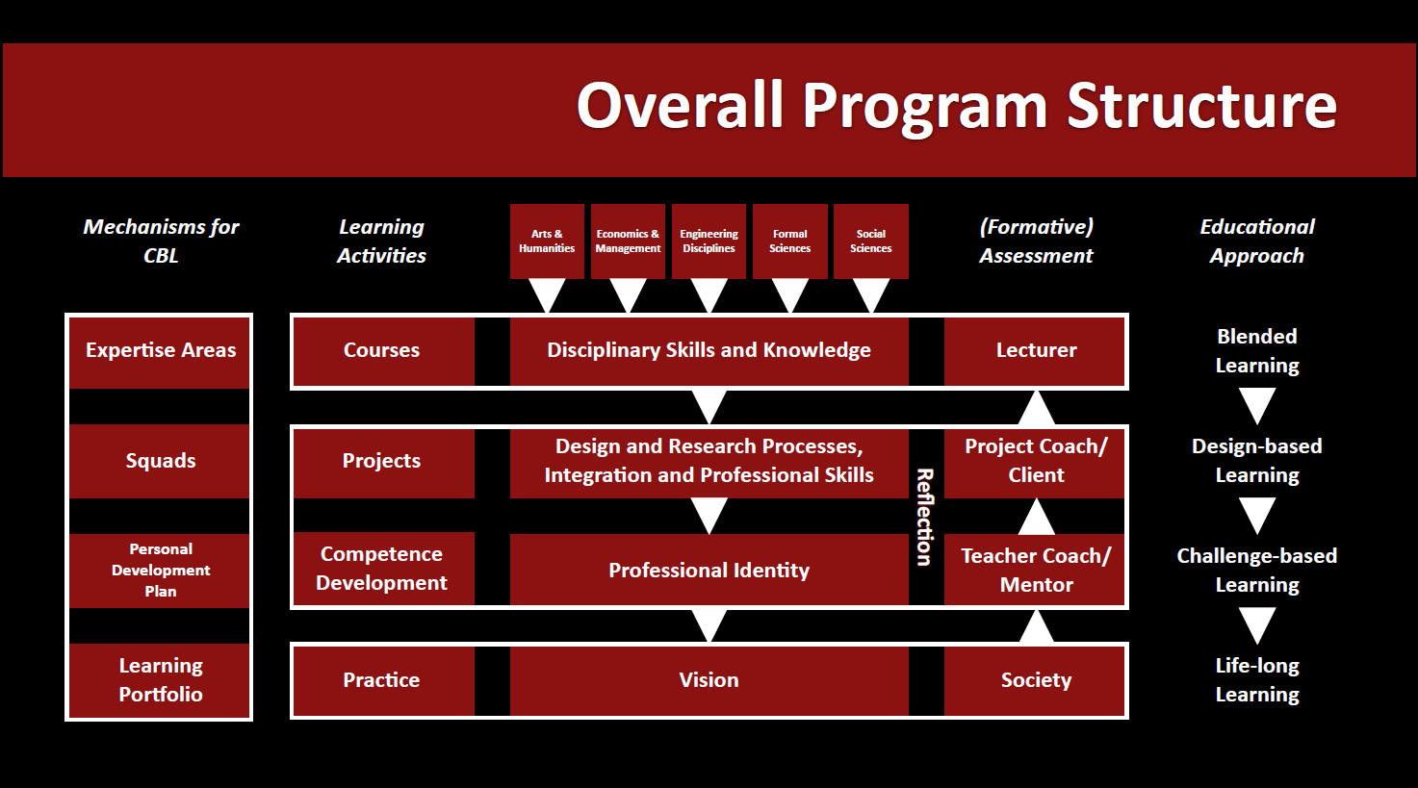
© Miguel Bruns (2020)

Slide 4
Research questions- Coaching practices at ID
Research Questions for coaches
(1) What is the coaching style of experienced versus novice coaches to support the different levels of learning?
(2) What are the student and contextual factors influencing coaches’ approach?
Research Questions for students
(1) How do students experience coaching depending on their needs and project characteristics?

Slide 5
Research methods
Observations of coaching interactions aimed at attaining an overall understanding of the coaches’ behaviors during those interactions
Interviews with coaches involved in the coaching sessions were conducted to gain in depth understanding of their own behavior with coaching in CBL/DBL.
Interviews with students, were conducted to assess students’ experiences with coaching in CBL/DBL approach.

Slide 6
Descriptive characteristics of study
Overview of methods and participants
Method
Qualitative | Instrument | N | Descriptive characteristics
 | Observations of coaching sessions | 9 | Individual projects:6 Group projects: 3
 | Interviews with coaches | 13 | Male: 9 Female:4 Expert:11 Novice: 2
 | Interviews with students | 26 | Bachelor:16 Premaster: 4 Master: 6
Data analysis
Qualitative analysis
Use of frameworks by Adams, 2016; Gomez Puente, 2013; Collins 1991

Slide 7
Framework to guide analysis of video recoded coaching sessions - Observations
Framework to guide development and analysis of interviews
Gómez Puente (2013) Coaching behaviors
The coach: formulates open questions to – FOQ acts as an expert, customer – AEF; provides feedback on progress – FPS; reviews progress on plans, proposal– RPP; provides feedback on evolving efforts– PTD; supports students in reflecting on and explicating rationales for technical design, argument formulation, and decision making– RER; supports students in case of difficulties– JIT; uses methods/tools to guide the team– UMT; encourages students to articulate engineering terminology – AET; encourages students to look back on previous actions/tasks and reflect what they learned from them– EAP encourages students to learn from other students’ plans– LEE; observes students during implementation of activities– OIA;
Adams (2016) Coaching process
Design process
Problem Framing Doing research Idea Fluency Deep Modelling Balance Tradeoffs Valid Experiments Focused Diagnostics Managed Iteration Reflection
Knowledge application Aesthetics Coherence Interactivity Practicality Novelty (UN)Predictability
Process management
Complexity Management Risk Management Time Management Multiple Perspectives Suggest Don’t Tell
Collins (1991) Cognitive Apprenticeship
Modeling Coaching Scaffolding Articulation Reflection Exploration

Slide 8
Figure 1. Overview of coaching actions performed during coaching sessions- Experts’ video observations

Slide 9
Coaching practices
Coaching practices (based on coaches' interviews) |  | Subthemes
Using open-ended questions throughout design process |  | Open question to justify decisions Open question to articulate reasoning
Focused on students’ professional vision |  | Start from students’ motivation Try to understand who the students are
Coaching on time planning and time management |  | Set expectations from the start Constant revising of plan
Coaching students on decision making |  | Think along with student Suggest many different options
Encouraging reflection on process- how you learn
Coaching students to change perspective from doing to learning
Coaching students to balancing big picture with details
Coaching students to different perspectives

Slide 10
Coaching practices
Asking critical questions to foster articulating of ideas
So some of the students will stick on a very specific idea, usually the first idea they had. So that means they didn't the dig much survey on this domain. So that's why as a coach, I will ask a lot of critical questions for the student to explain, “why you want to do this?” and maybe suggest he can go some different directions (novice coach)
Set expectations
“There are multiple iterations. Plan them out. You have to sit down and unpack with each other. Think of the methodology, the other job is to develop a mechanism of what you have done and what you’re going to do…” (expert coach)
Change perspective from doing to learning
“So I think that's, that's one of the first things to changing that perspective, that you're not doing it to pass to pass courses, but to develop your to develop yourself and to see, what you want to what you want to learn from it, and how its contributes to your, to your development” (expert coach)
Multiple ideas
But I also always try to then come up with a richness of possible ideas. Because if I come up with one suggestion, you know that next week, they have adopted that idea and come up with should take over your idea and continue with that. Whereas it's not meant to say this is what you should do (expert)​

Slide 11
Student and contextual factors influencing coaches’ approach
Students’ level of experience
In the lower year, during idea generation, coaching is very much needed. In the last part, where they're they' re building prototypes and stuff, there is less coaching needed, because it's mainly it's clearer what needs to be done. And in the higher year projects, it's mainly seeing the bigger picture and making them see the bigger picture and have them not drown in details, elements of the process or in detailed expertise areas (expert coach).
Group versus individual projects
So I think with group projects, it's just easier, like students have more experience doing group projects. And if it's individual projects, you really have to think along with them. Right, like, so what did you do before on your prior projects? What are your interests? What did you like about them? (novice coach).
Open-ended versus defined project
So they get a specific brief on what they have to design. And very easy when it’s very detailed. But it depends on the level of students, right? bachelor, they need more guidance masters a bit less, If it’s really broad, you need to definitely guide them a bit. Give them at least two three different options on what they could do (novice coach).

Slide 12
Students’ perspective
General guidance on design process
“Coaches expect that students come up with question but students need more guidance- they might feel lost if coach answers only their own question” (bachelor student)
“Students might need support to formulate other questions or to adopt multiple perspectives” (bachelor student)
Decision Making
“FBP projects are harder for students- students need more support- emotional or practical- students more experience but first time working alone- decision making very difficult” (FBP student)
Encouragement and motivation
“It is nice if you see the coach really passionate about your project. It give you energy”.

Slide 13
Conclusions: Coaches
Expert coaches:
Monitor more often the planning and tasks of students.
Can coach projects beyond their expertise areas/knowledge.
Important to get students to look at the problem from different perspectives.
Motivation from coach.
Culture of reflection: helping students reflect on process.
Big picture while paying attention to details: Is it connected to initial phase/idea?
Novice coaches:
For new teachers: ‘hidden knowledge’ and not always tangible or easy to perceive, e.g. assessment system.
Want to coach projects in which they have expertise. “If student fails I have failed as well”.
Link novice students to 'experienced buddies'.

Slide 14
Conclusions: Students
Students are familiar with PI&V and (more developed) self-directed attitude
FBP students need more support
Distribution of time through the project: not enough time at the end to implement the solution
Time management support but expectation from coaches to observe that time and final product needs to be in balance will be appreciated
Students expected more attention from coaches in order to keep them motivated (during the Corona time) and show interest.
Students don’t admit that they don’t know. Good to show how things ‘work’.

Slide 15
Next steps in our research
Study 2: squad level
Study 1
Squad Characteristics
Constructive alignment
Teacher level
Student level
Content learning
Coaching practices
SDL/ PDP

